Slide 1

Business Plan
Presentation
Briefly describe the contents of the presentation or
the purpose of the meeting. Tell your audience
what to expect.

Slide 2
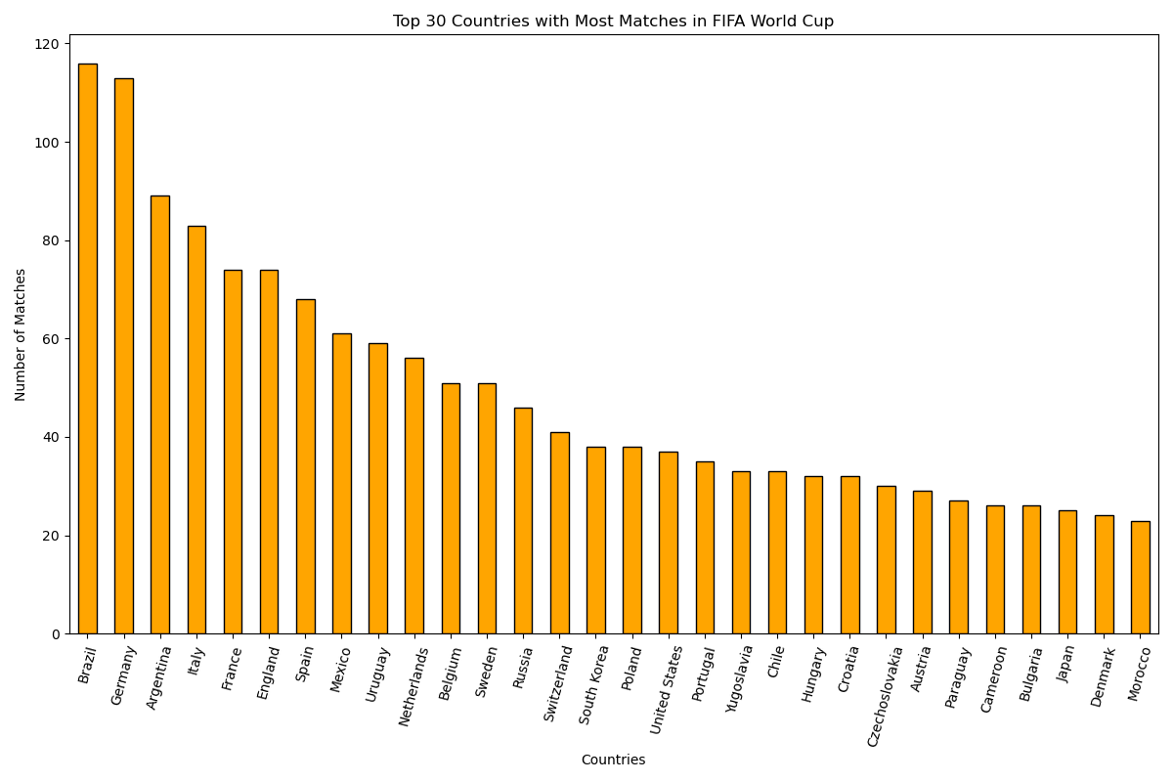

Slide 3
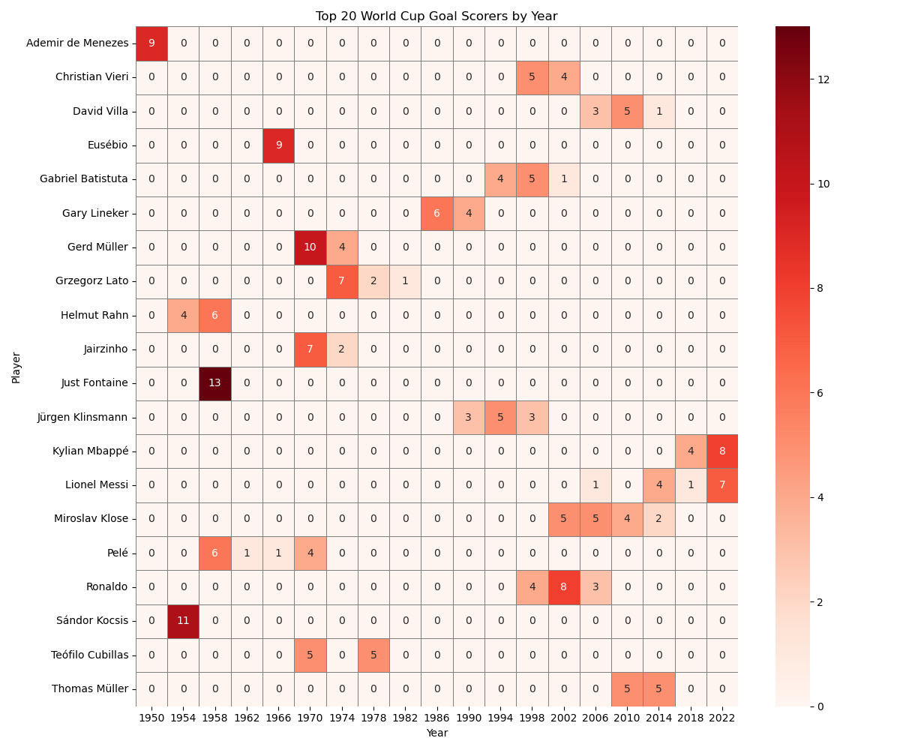

Slide 4


Slide 5


Slide 6
